Slide 1
Modern CNNs
Sungjoon Choi
(sungjoon.choi@cpslab.snu.ac.kr)

Slide 2
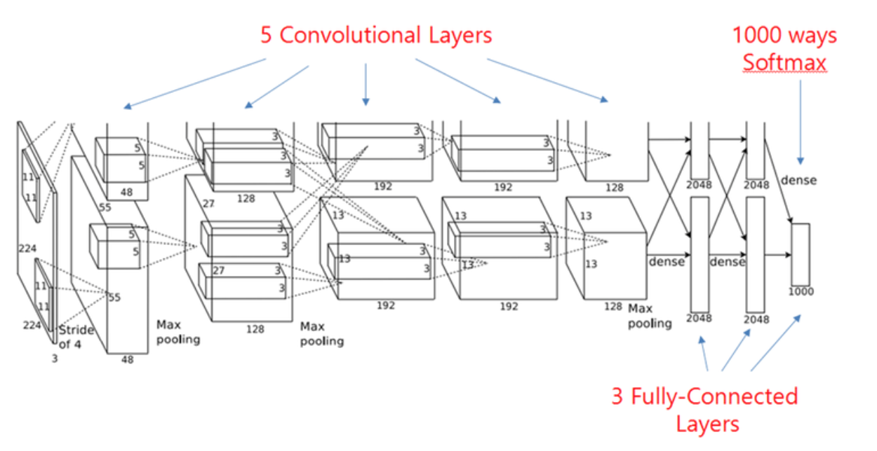
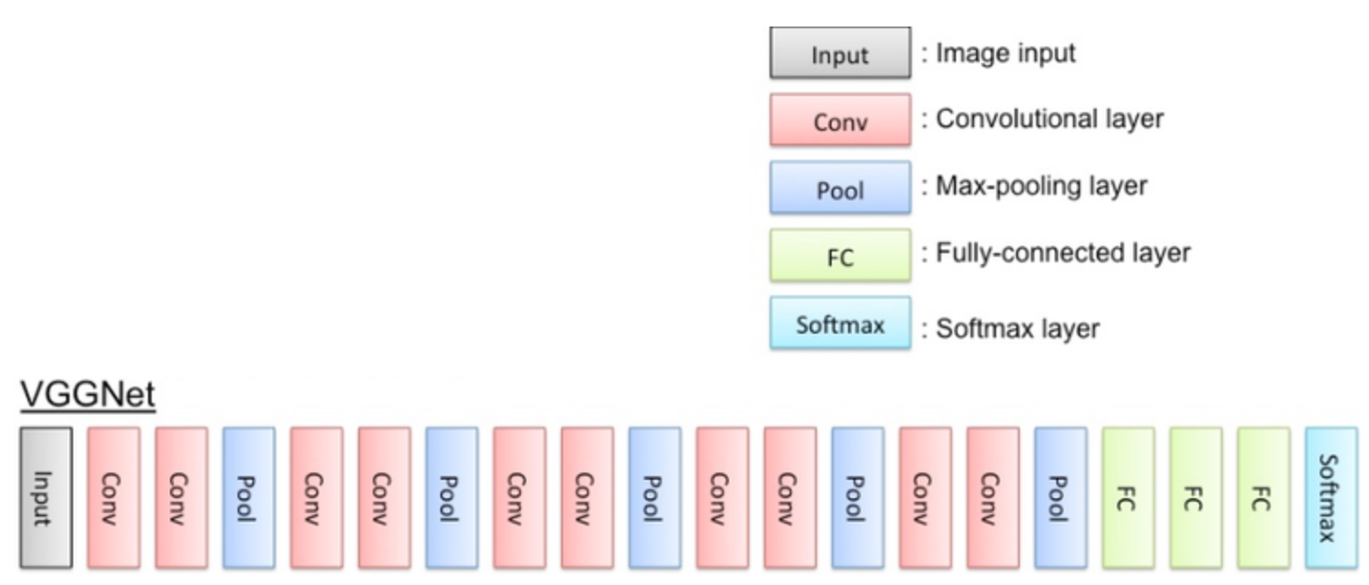
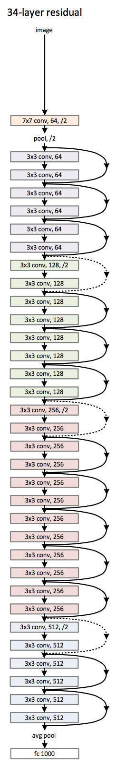
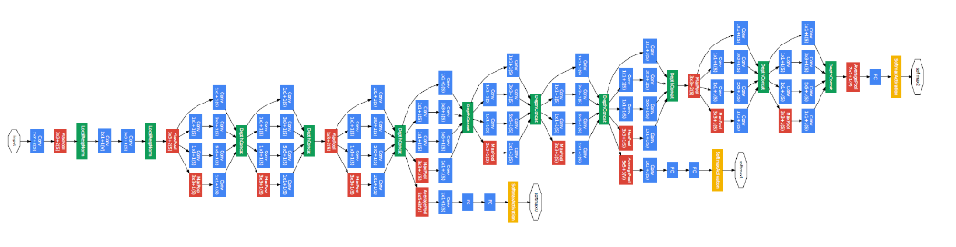
CNN Architectures
AlexNet
VGG
GoogLeNet
ResNet

Slide 3
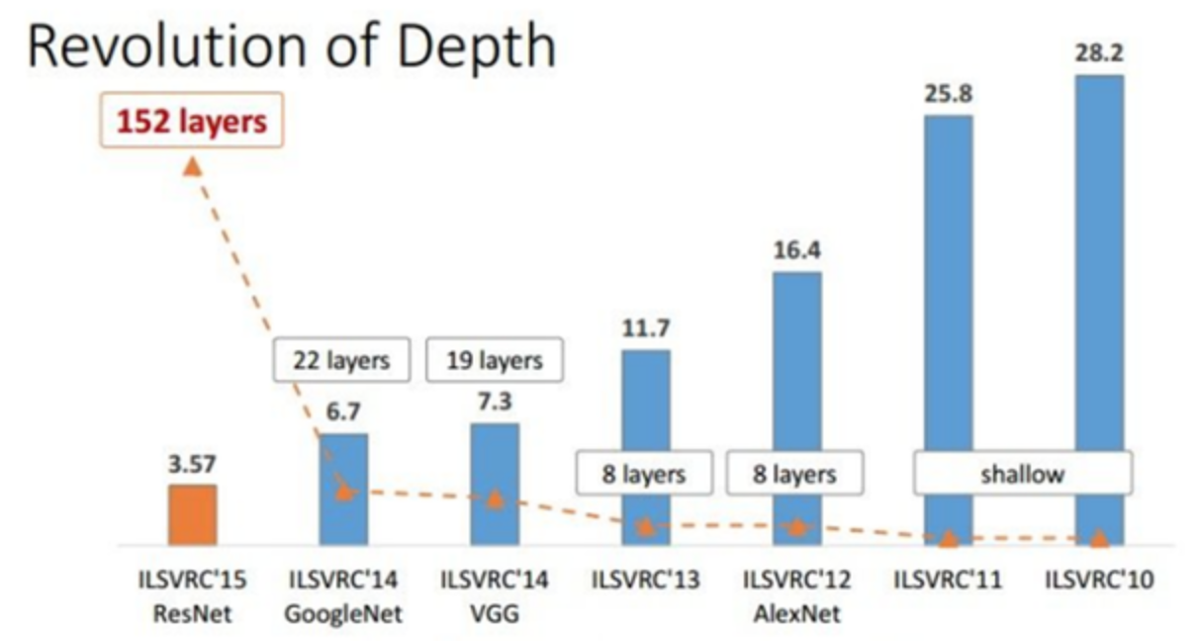
Top-5 Classification Error

Slide 4
AlexNet

Slide 5
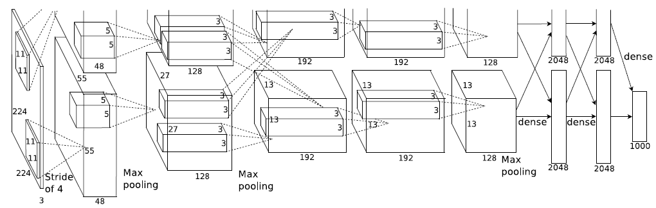
AlexNet
What is the number of parameters?
Why are layers divided into two parts?

Slide 6
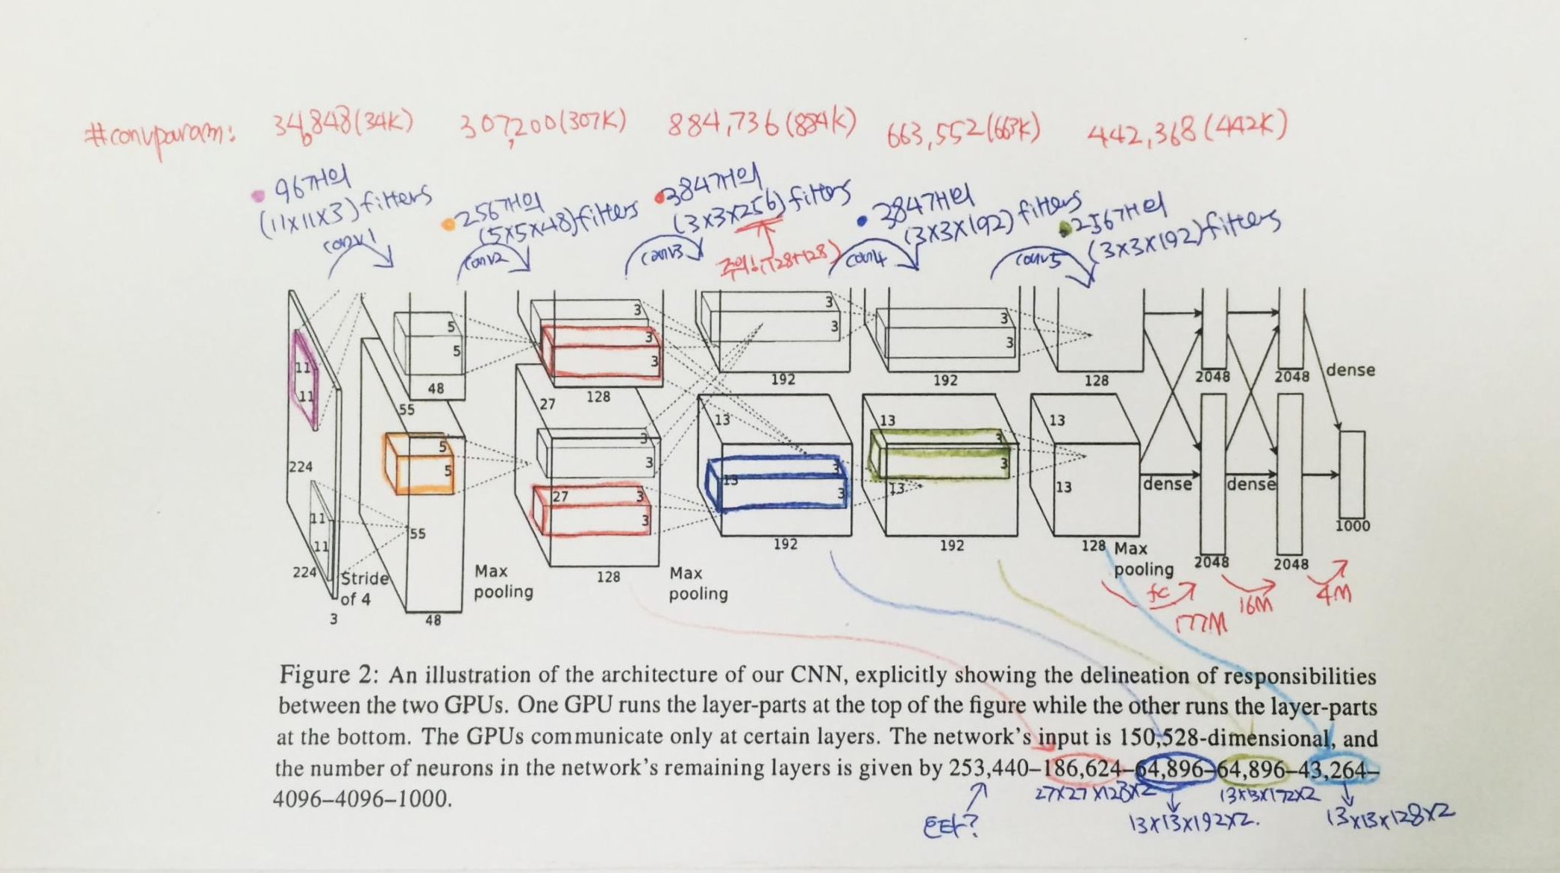
AlexNet

Slide 7
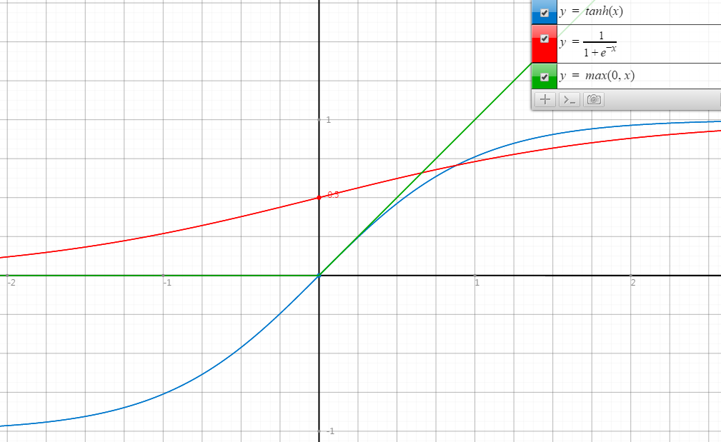
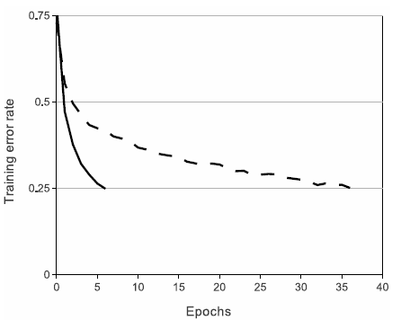
ReLU
Rectified Linear Unit
ReLU
tanh
Faster Convergence!

Slide 8
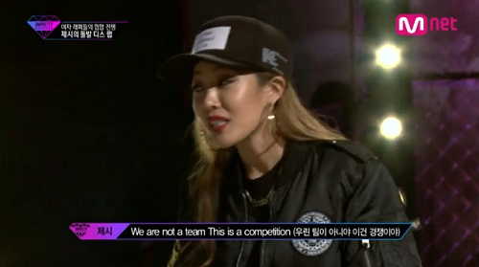
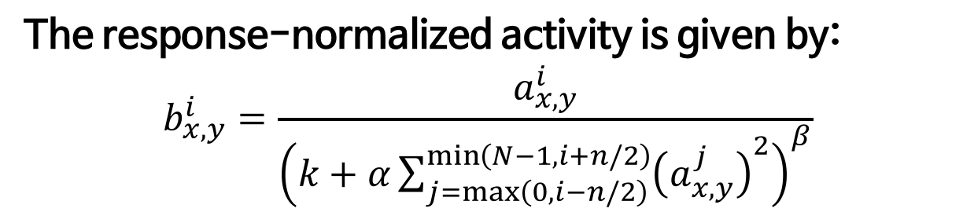
LRN
Local Response Normalization
The response-normalized activity is given by:
$$b_{x,y}^{i}=\frac{a_{x,y}^{i}}{{\left(k+α\sum_{j=\max\left(0, i−n/2\right)}^{\min\left(N−1, i+n/2\right)}{{\left(a_{x,y}^{j}\right)}^{2}}\right)}^{β}}$$
It implements a form of lateral inhibition inspired by real neurons.

Slide 9

Regularization in AlexNet
Main objective is to reduce overfitting.
More details will be handled in next week.
In the AlexNet, two regularization methods are used.
Data augmentation
Dropout

Slide 10
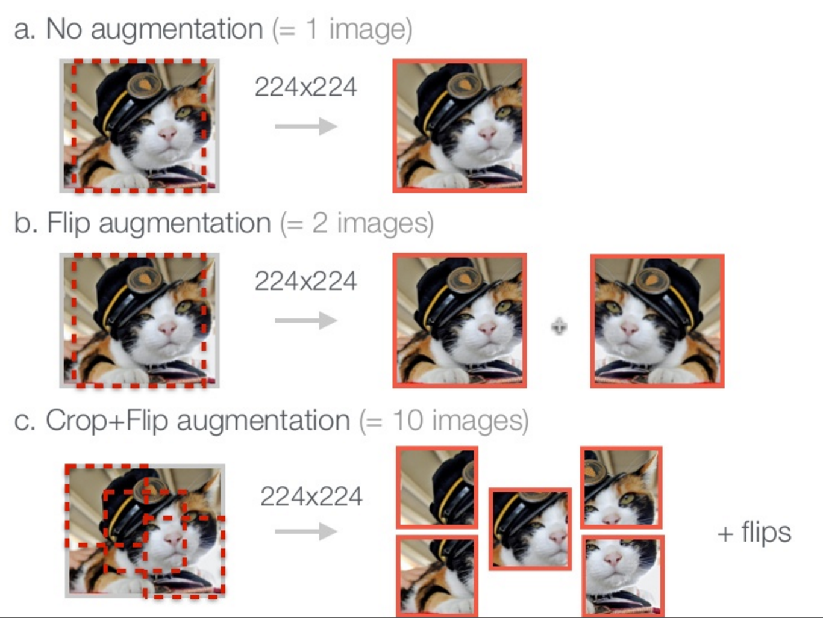
Data augmentation
http://www.slideshare.net/KenChatfield/chatfield14-devil

Slide 11
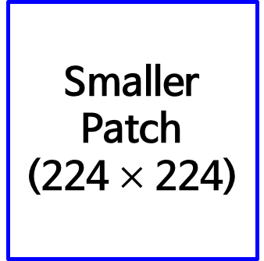
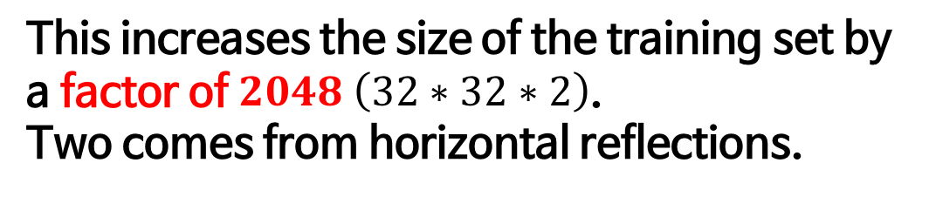

Data augmentation in AlexNet
Original Image
(256 $×$ 256)
Smaller Patch
(224 $×$ 224)
This increases the size of the training set by a factor of $2048 \left(32∗32∗2\right)$.
Two comes from horizontal reflections.

Slide 12
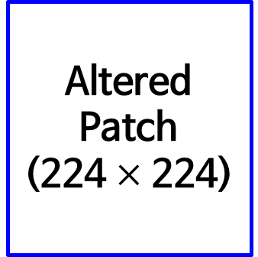
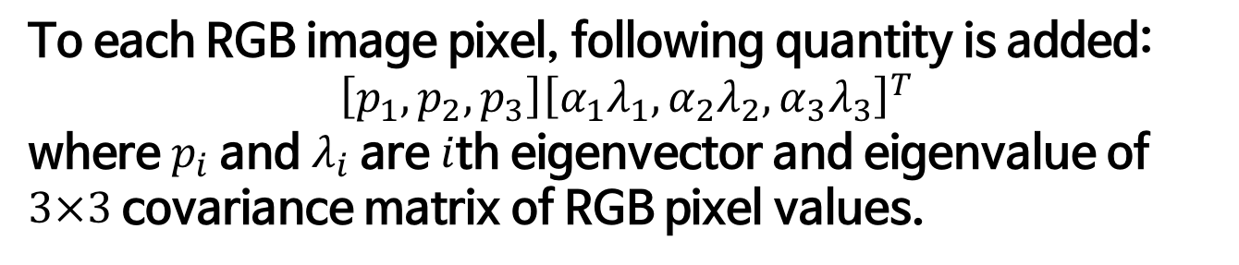
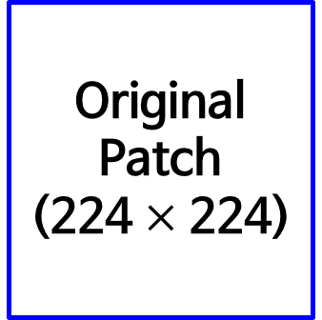
Data augmentation in AlexNet
Original Patch
(224 $×$ 224)
Altered Patch
(224 $×$ 224)
Color variation
To each RGB image pixel, following quantity is added:
$$\left[p_{1}, p_{2}, p_{3}\right]{\left[α_{1}λ_{1},α_{2}λ_{2},α_{3}λ_{3}\right]}^{T}$$
where $p_{i}$ and $λ_{i}$ are $i$th eigenvector and eigenvalue of $3×3$ covariance matrix of RGB pixel values.
Probabilistically, not a single patch will be same at the training phase! (a factor of infinity!)

Slide 13
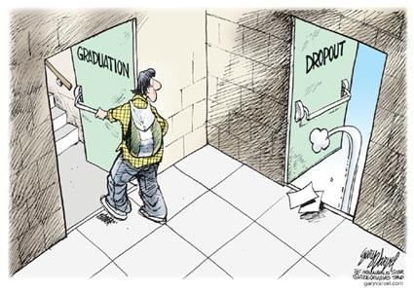
Dropout
Original dropout [1] sets the output of each hidden neuron with certain probability.
In this paper, they simply multiply the outputs by 0.5.
[1] G.E. Hinton, N. Srivastava, A. Krizhevsky, I. Sutskever, and R.R. Salakhutdinov. Improving neural networks by preventing co-adaptation of feature detectors. arXiv, 2012.
http://www.eddyazar.com/the-regrets-of-a-dropout-and-why-you-should-drop-out-too/

Slide 14
Must remember!

Slide 15
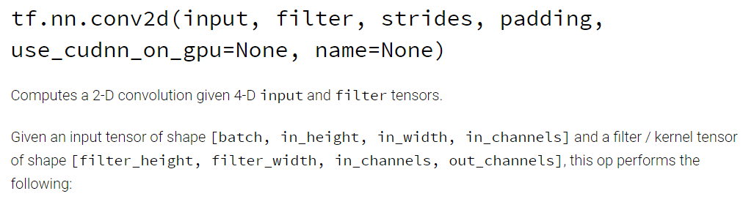
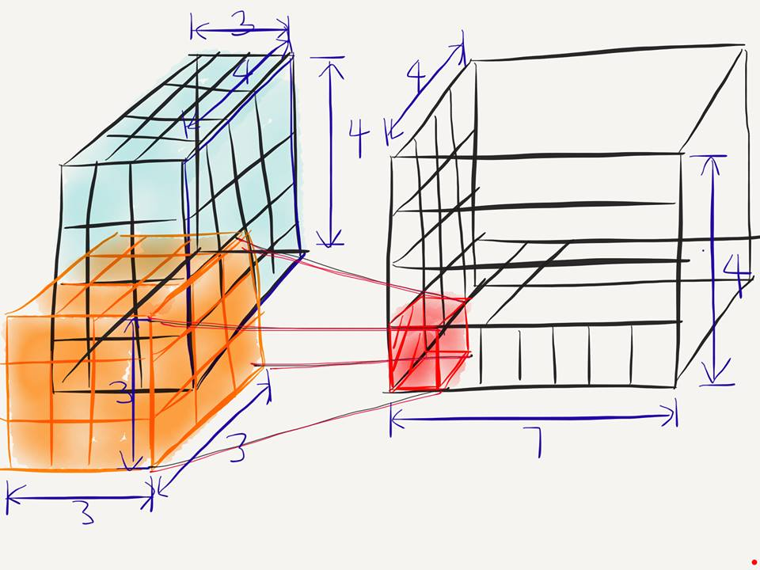
Conv2D
[batch, in_height, in_width, in_chnnel]
[filter_height, filter_width, in_channels, out_channels]
[batch, in_height=4, in_width=4, in_chnnel=3]
[filter_height=3, filter_width=3, in_channels=3, out_channels=7]

Slide 16
Conv2D
[batch, in_height=4, in_width=4, in_chnnel=3]
[filter_height=3, filter_width=3, in_channels=3, out_channels=7]
What is the number of parameters in this convolution layer?
→ $189= 3∗3∗3∗7$

Slide 17
VGG

Slide 18
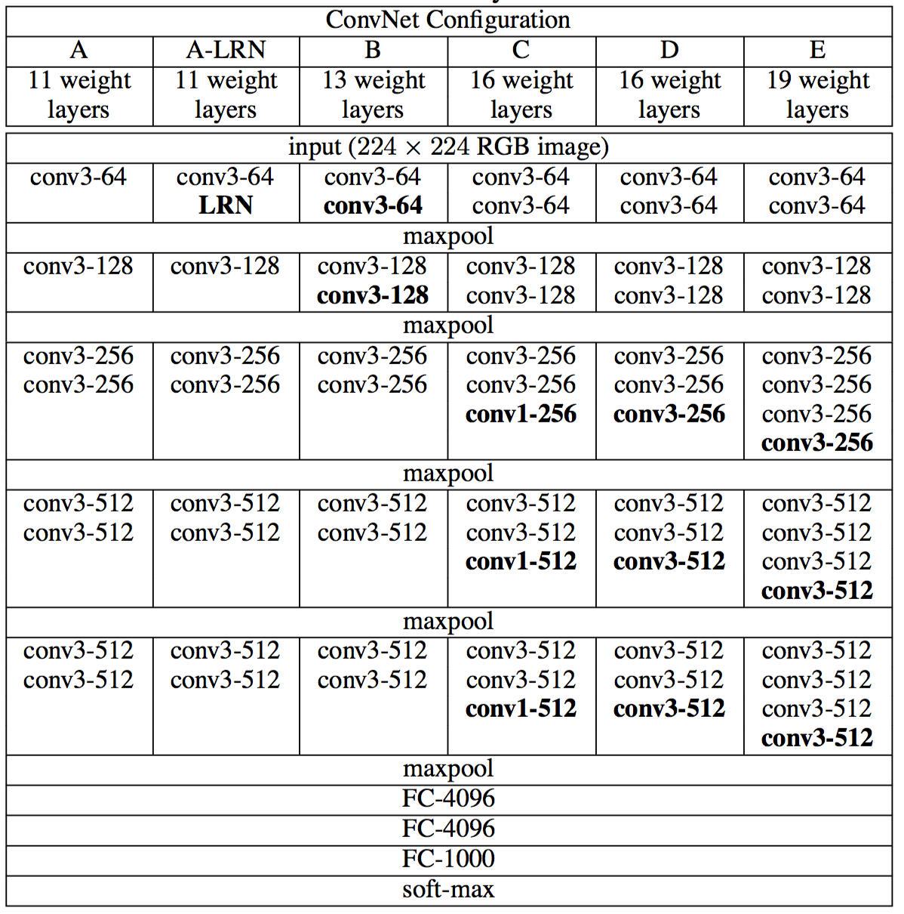
VGG?

Slide 19
GoogLeNet

Slide 20


GoogLeNet

Slide 21
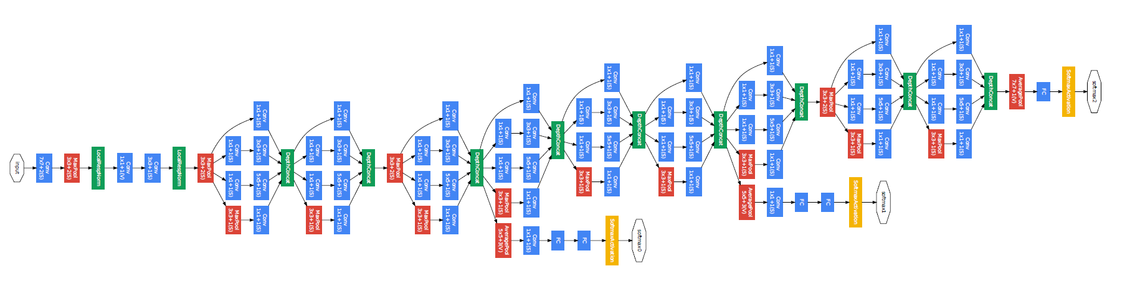
GoogLeNet
22 Layers Deep Network
Efficiently utilized computing resources, “Inception Module”
Significantly outperforms previous methods on ILSVRC 2014

Slide 22
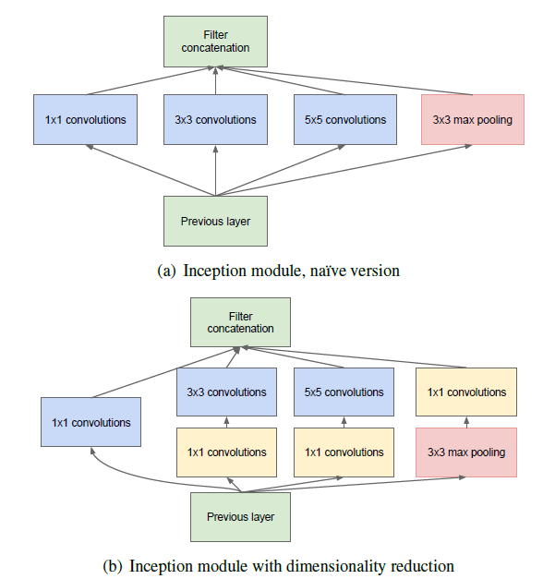
Inception module

Slide 23
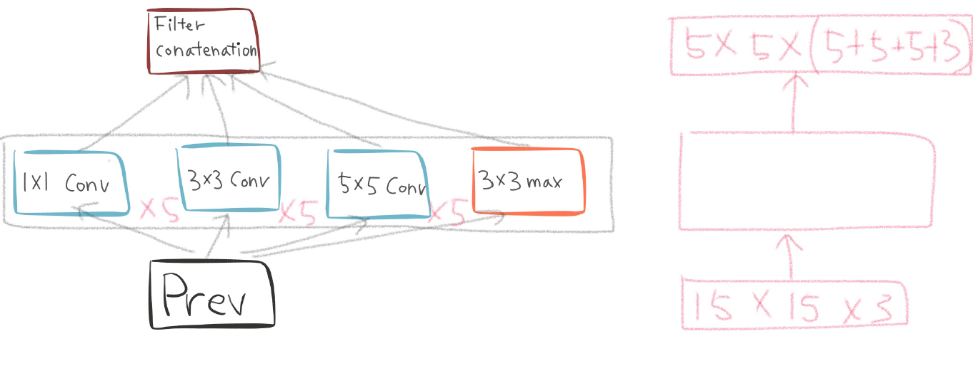
Naïve inception module

Slide 24
Naïve inception module

Slide 25
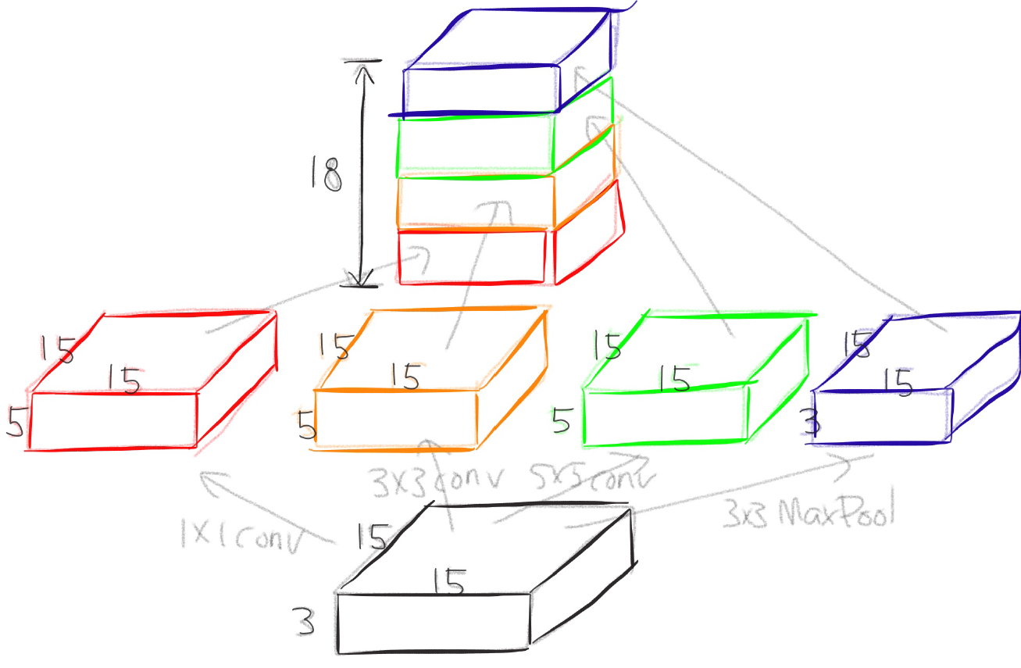
Naïve inception module

Slide 26
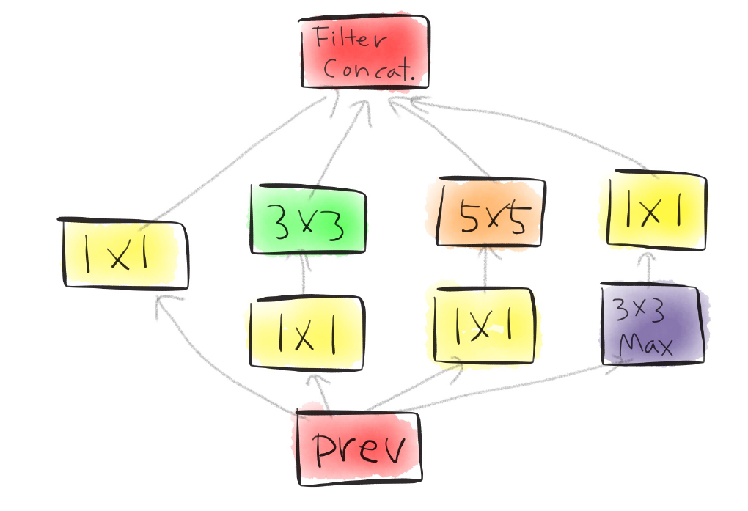
Actual inception module

Slide 27
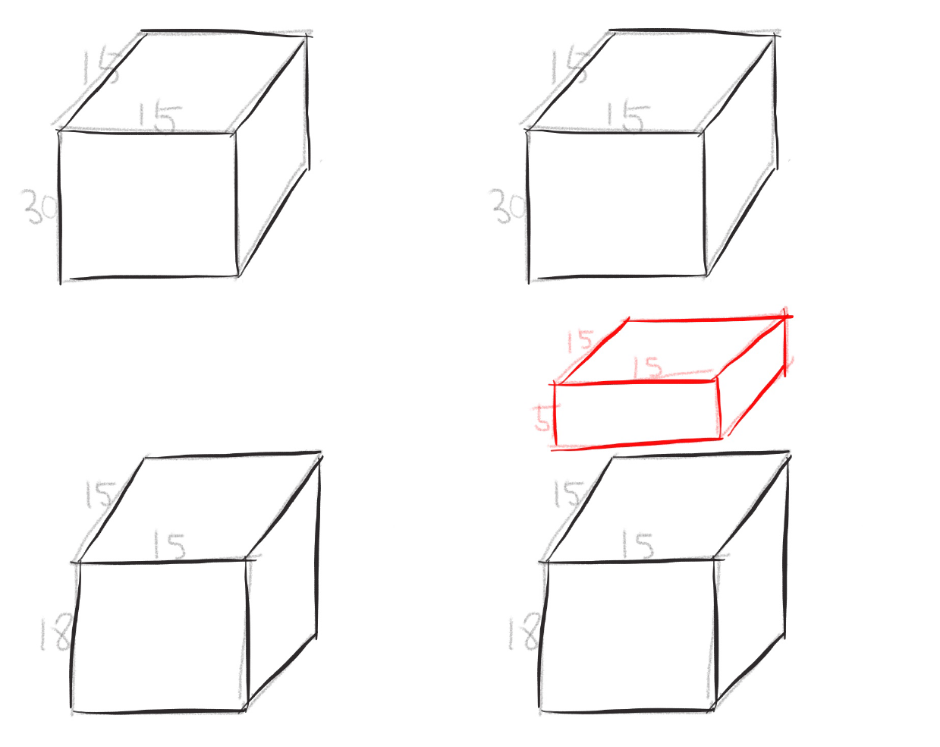
One by one convolution

Slide 28
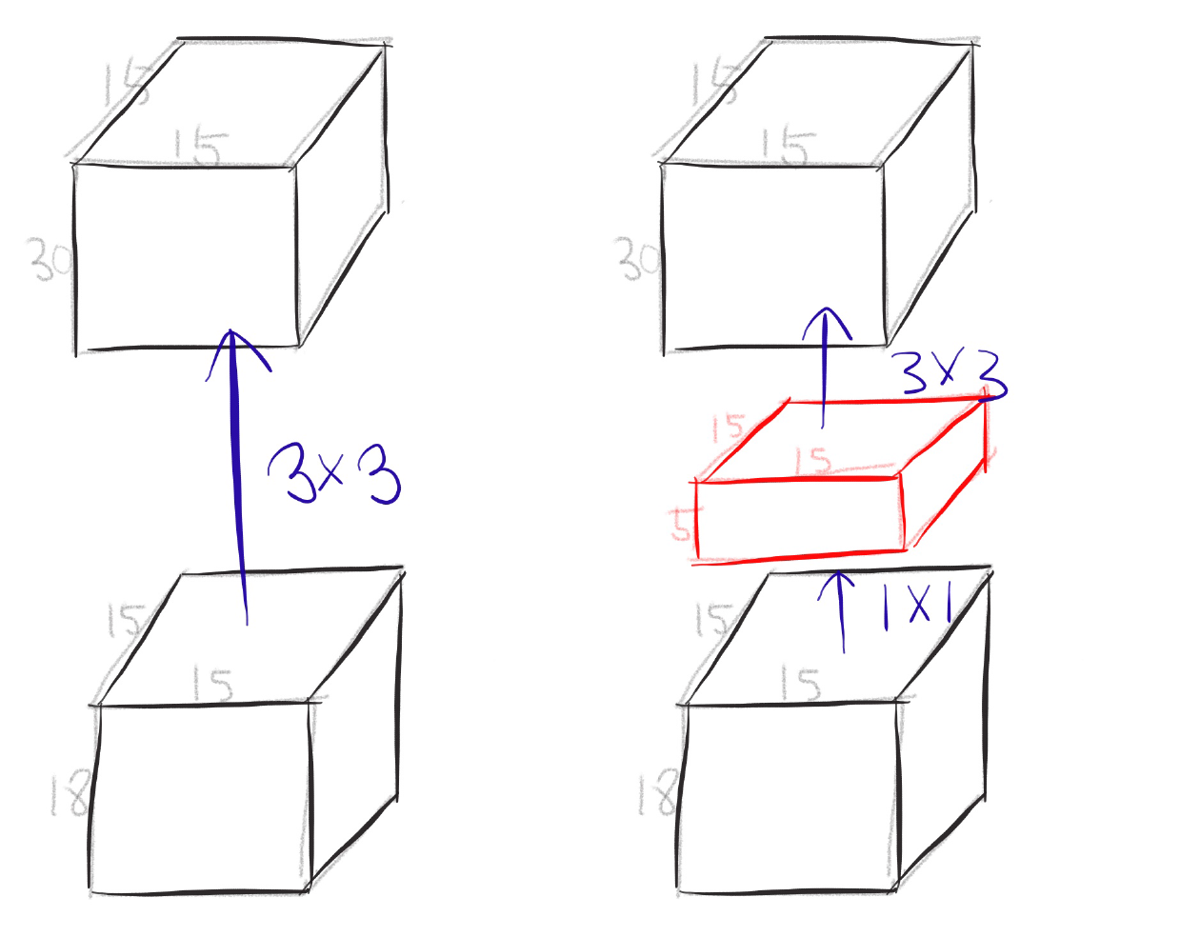
One by one convolution

Slide 29
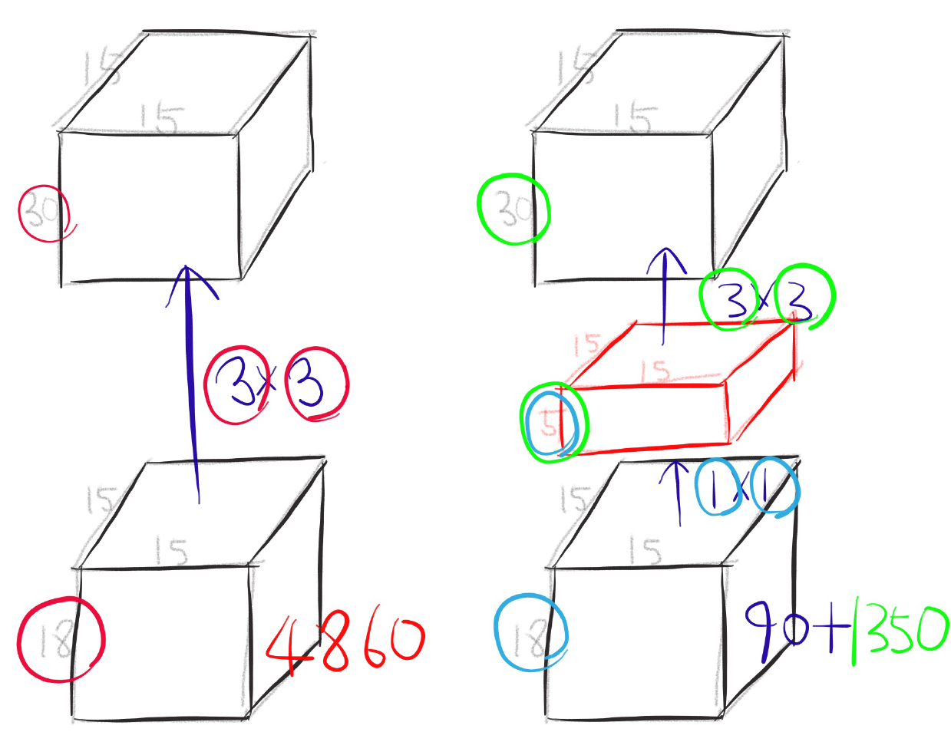
One by one convolution

Slide 30
GoogLeNet
Network in Network!

Slide 31
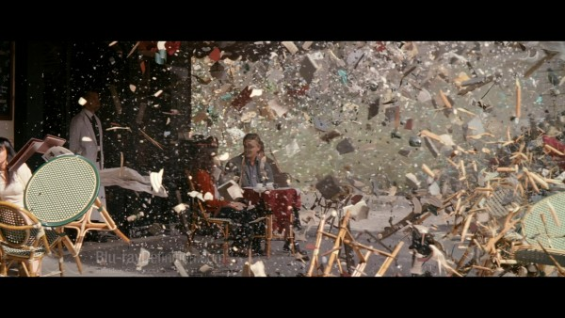
Conclusion
Very clever idea of using one by one convolution for dimension reduction!
Other than that...

Slide 32
Inception-v4, Inception-ResNet and the Impact of Residual Connections on Learning

Slide 33
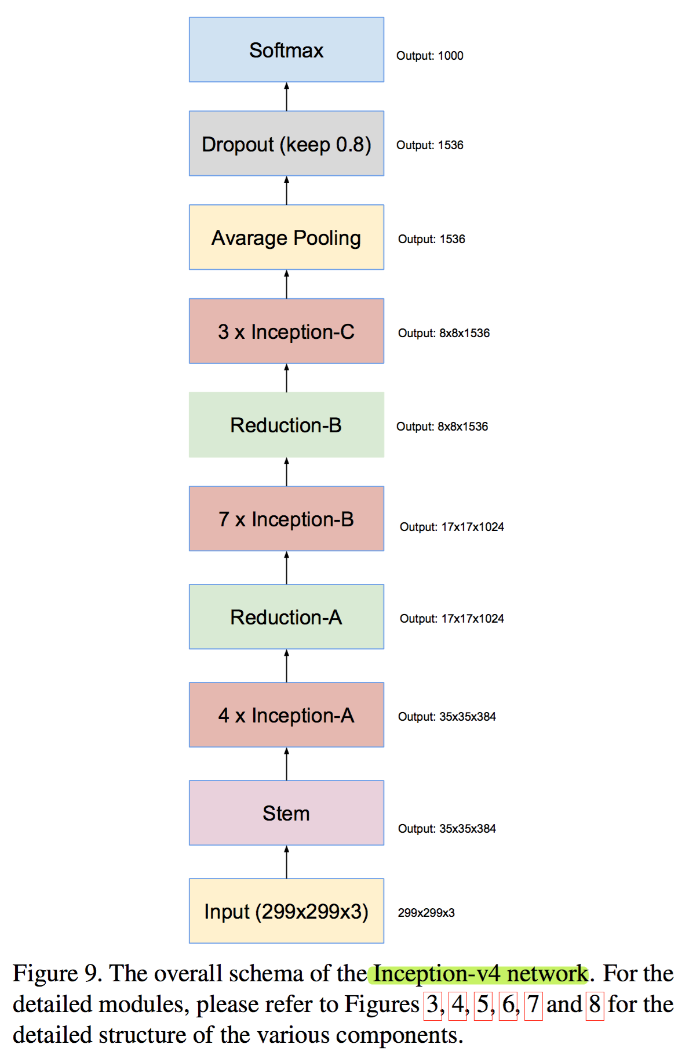
Inception v4

Slide 34
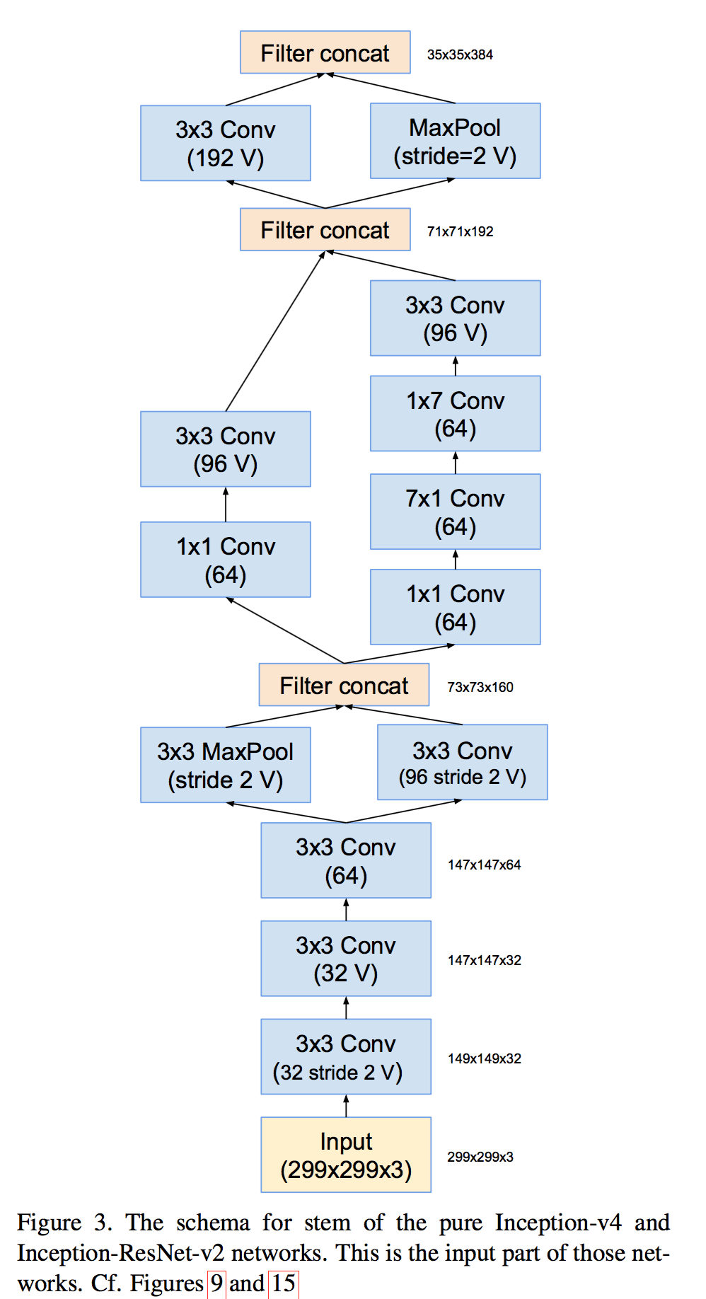
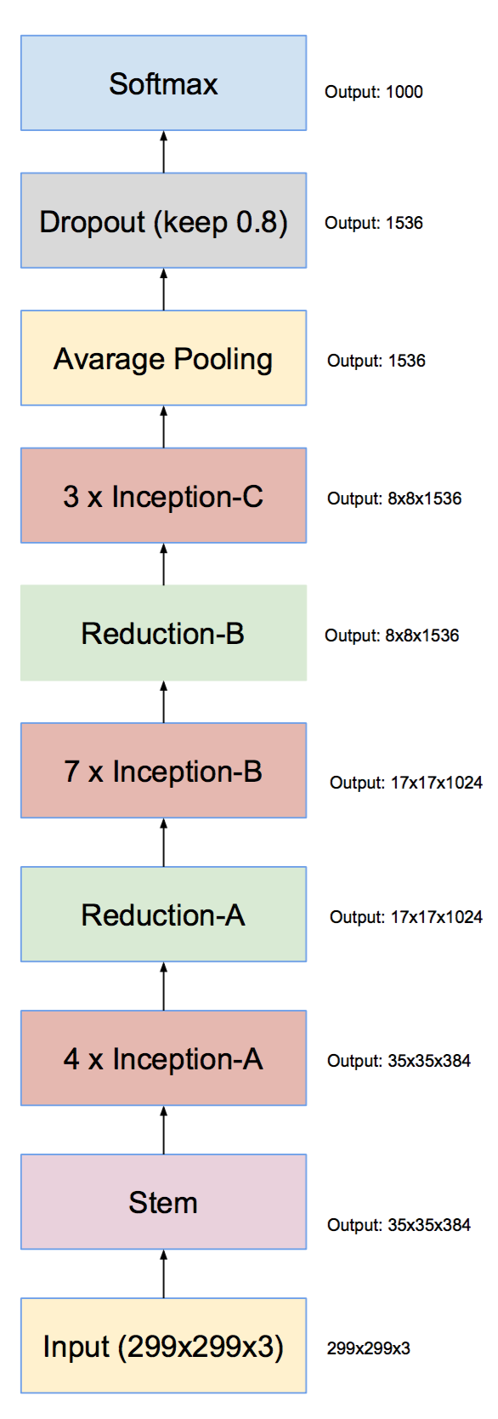
Inception v4

Slide 35
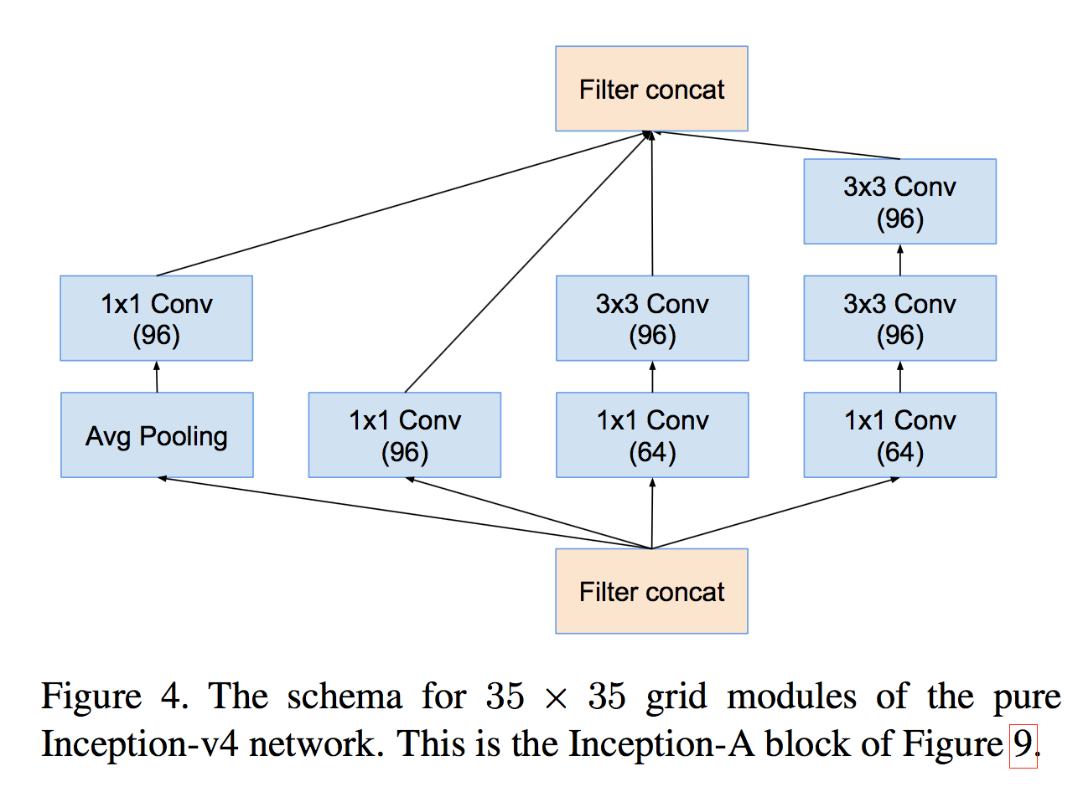
Inception v4

Slide 36
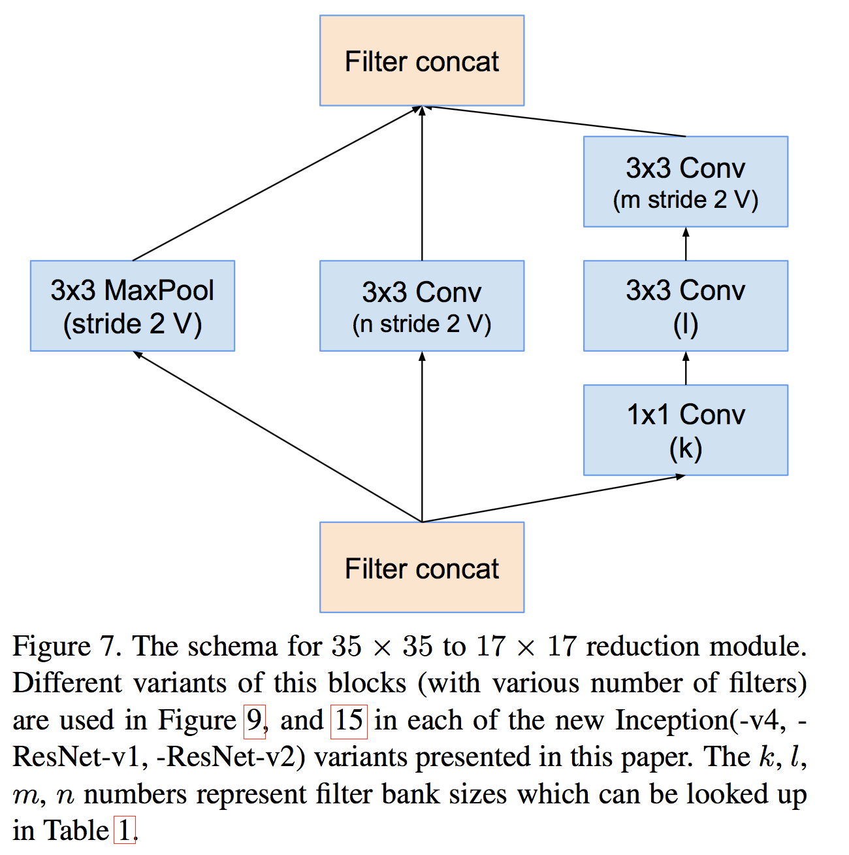
Inception v4

Slide 37
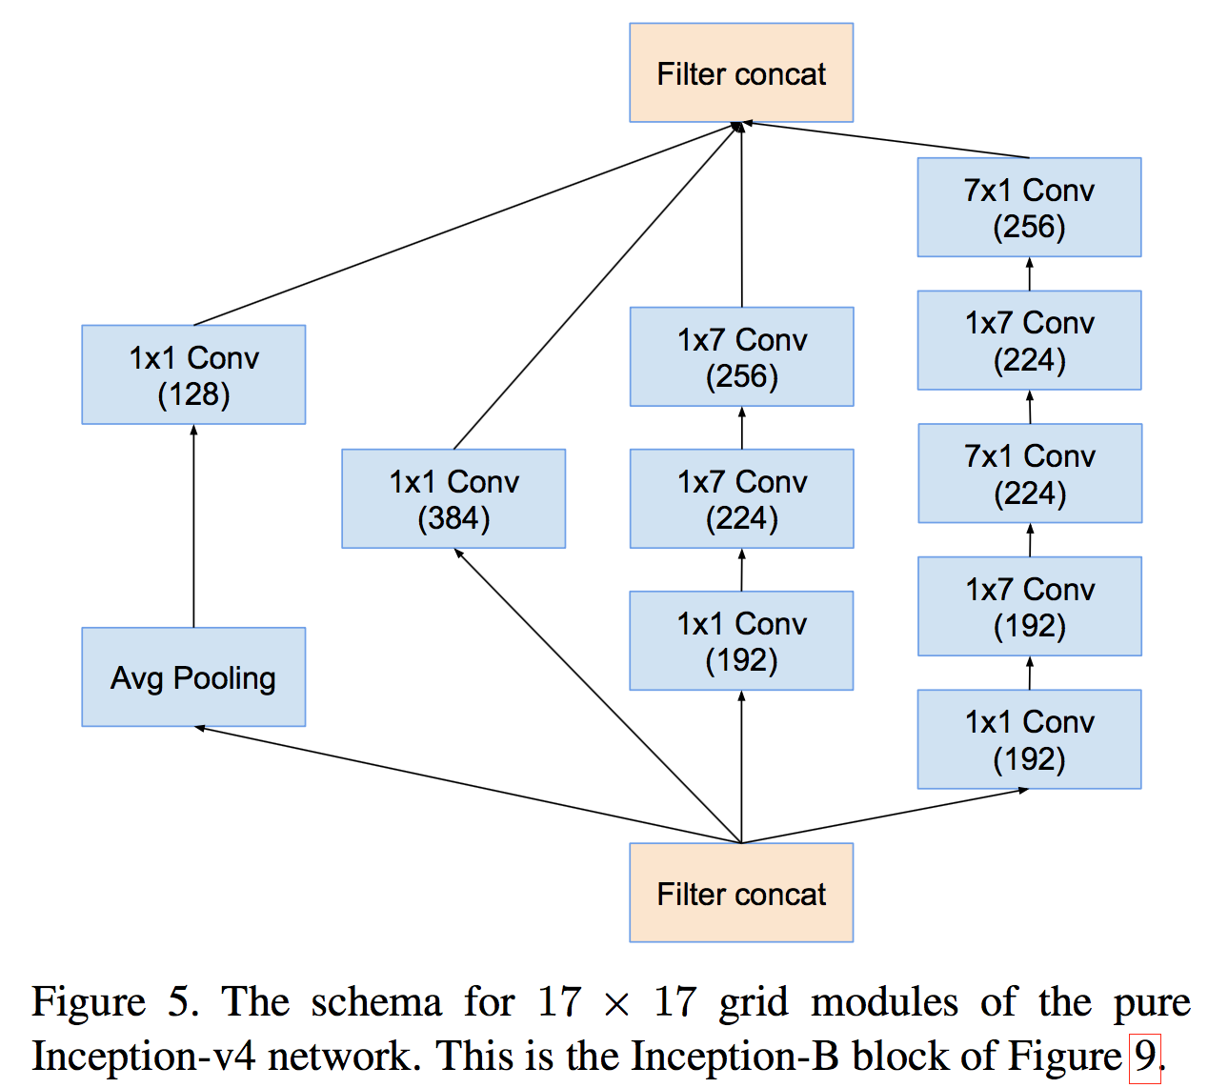
Inception v4

Slide 38
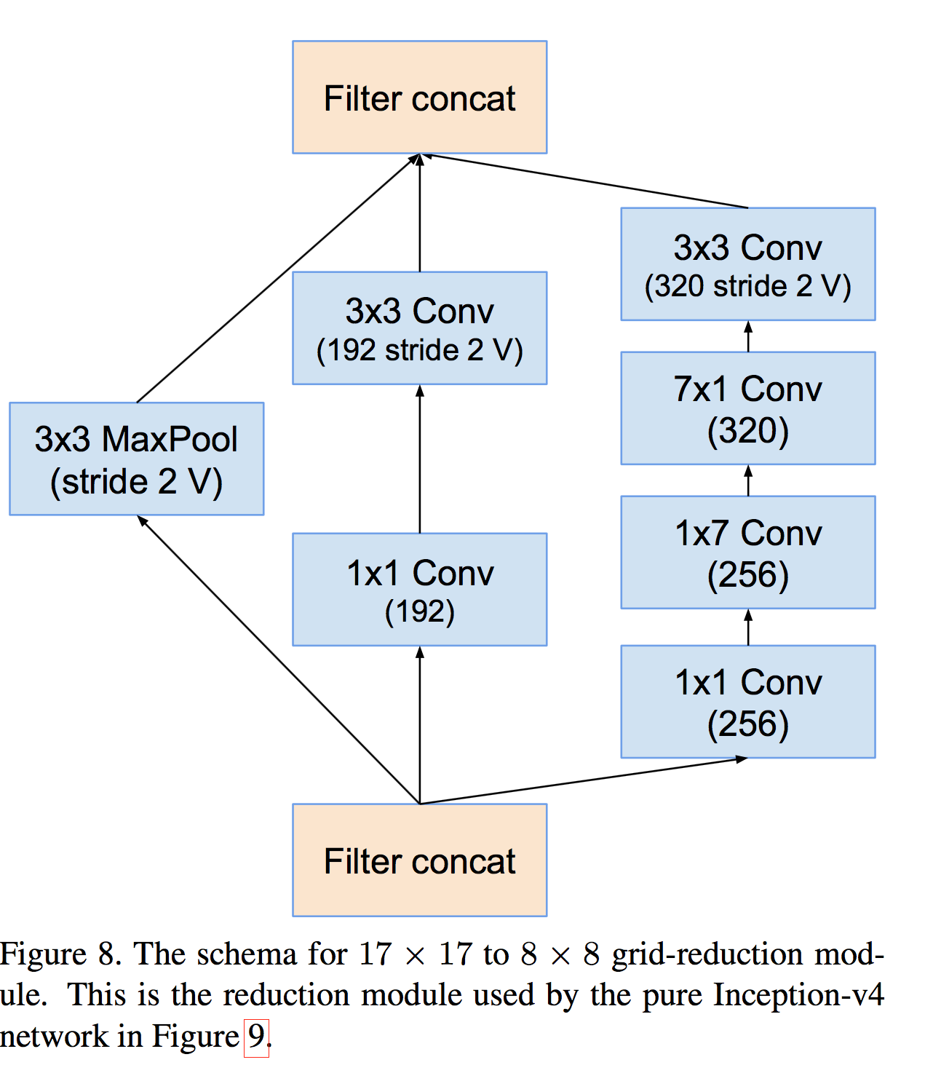
Inception v4

Slide 39
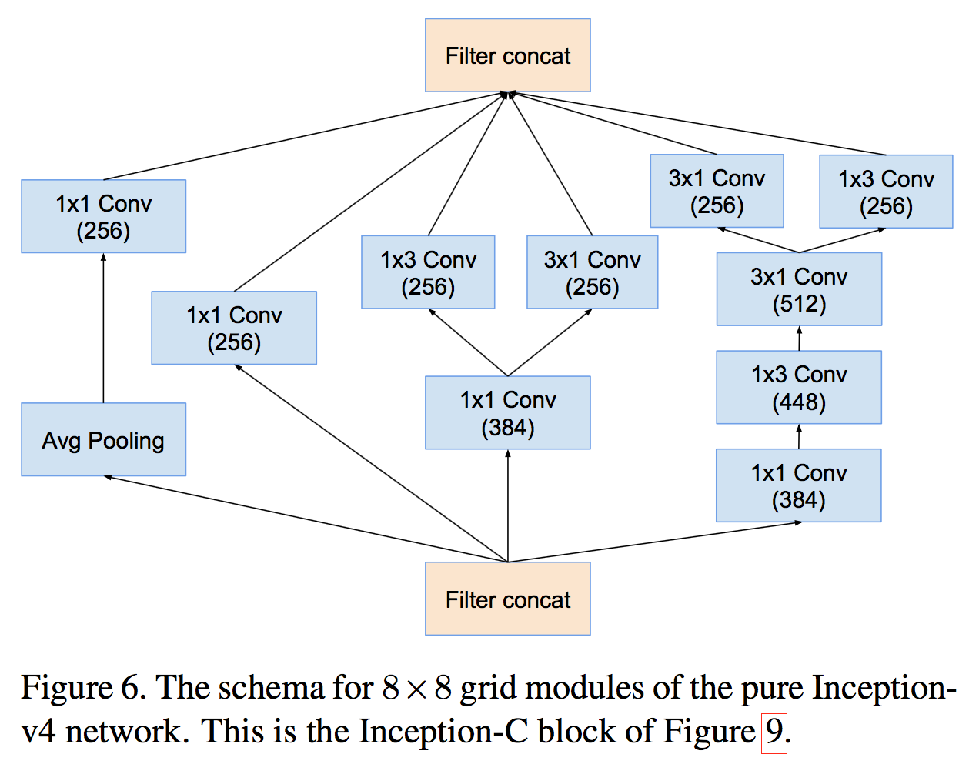
Inception v4

Slide 40
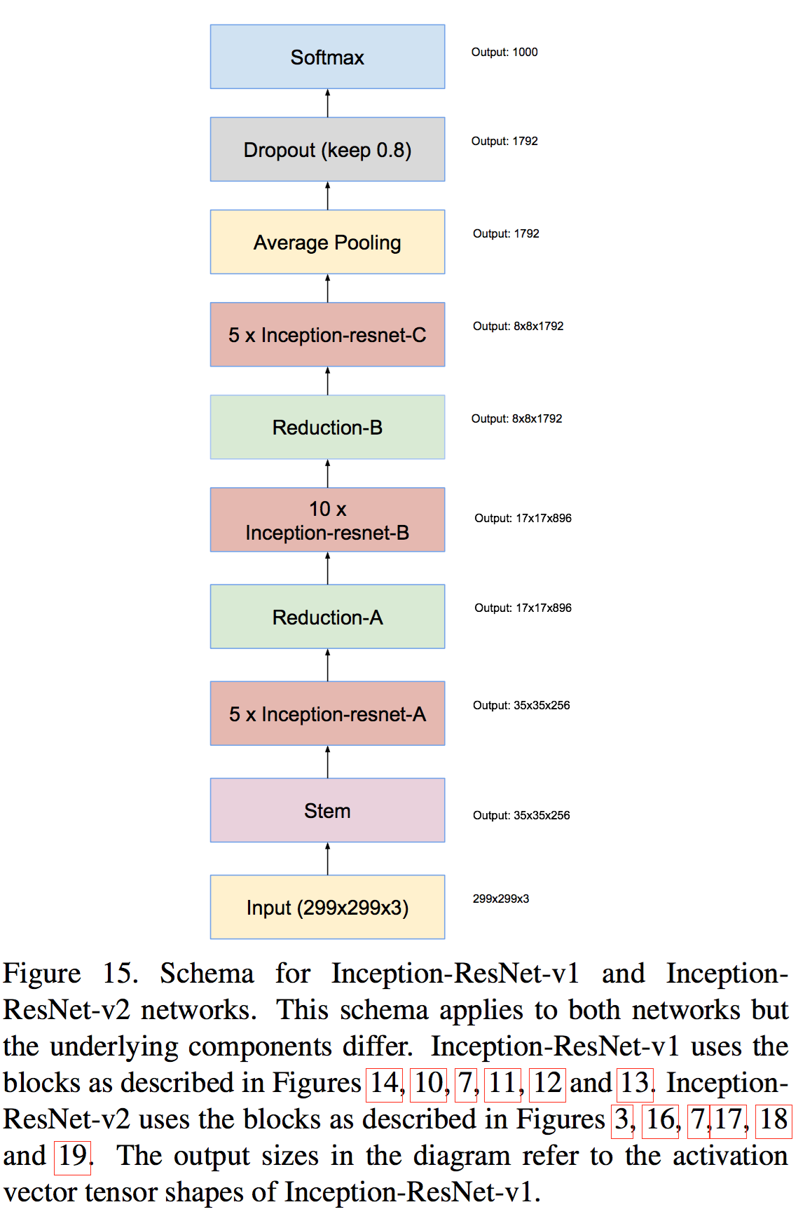
Inception-ResNet-v1

Slide 41
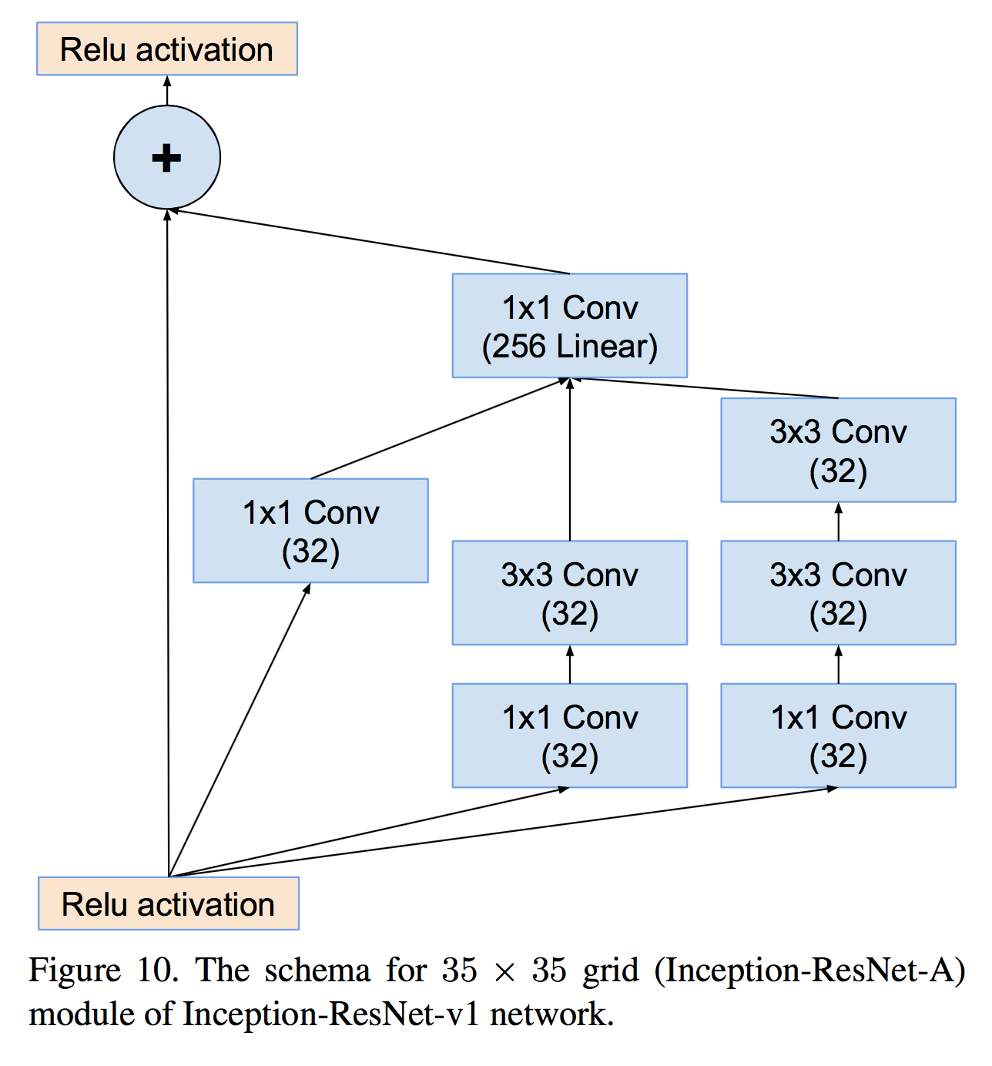
Inception-ResNet-v1

Slide 42
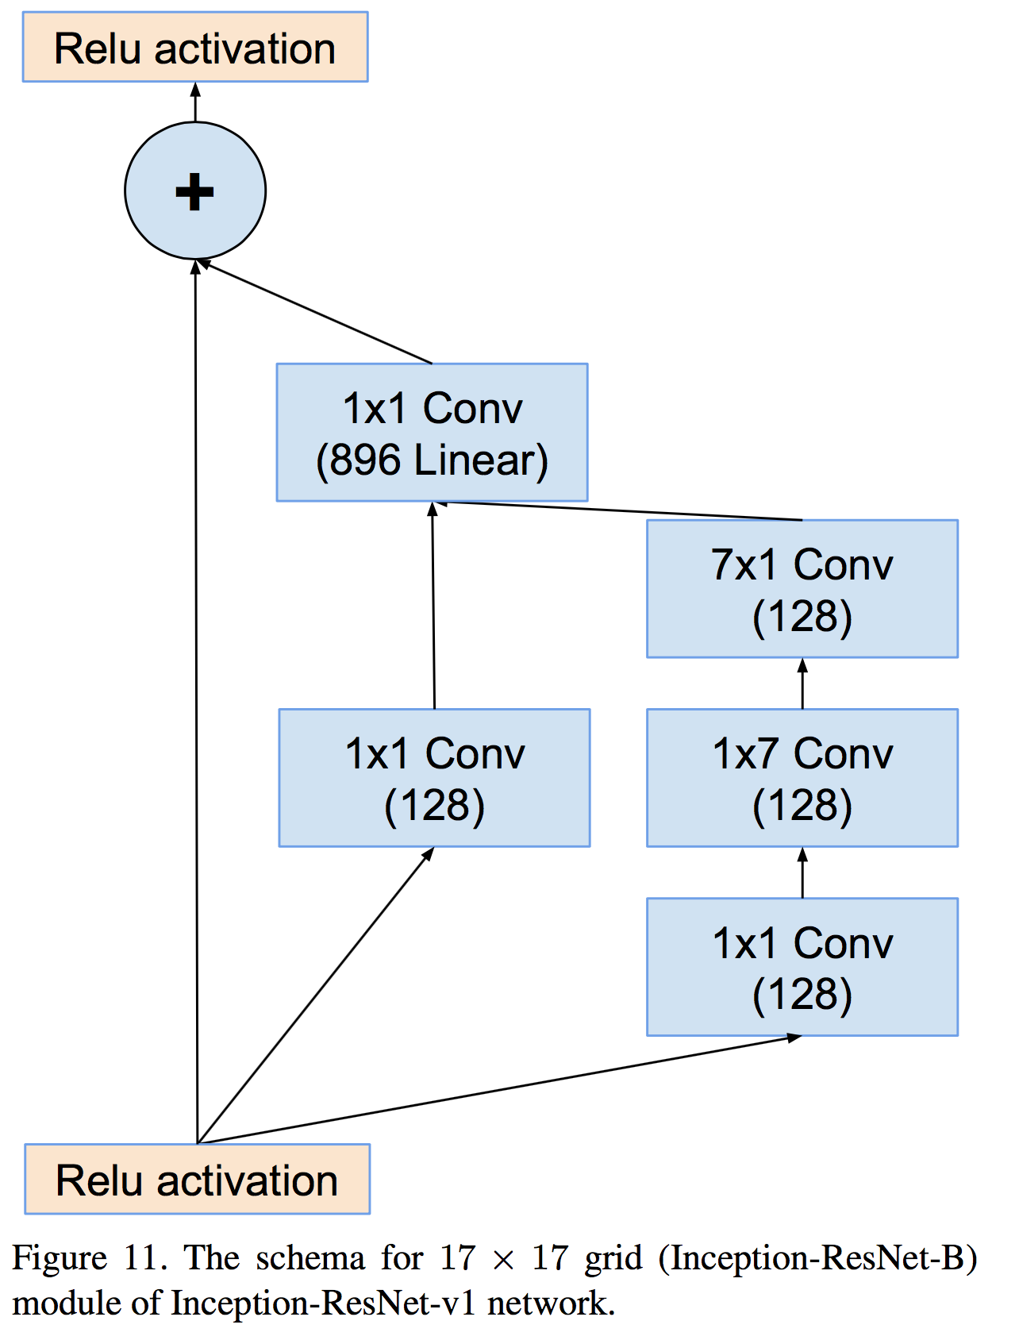
Inception-ResNet-v1

Slide 43
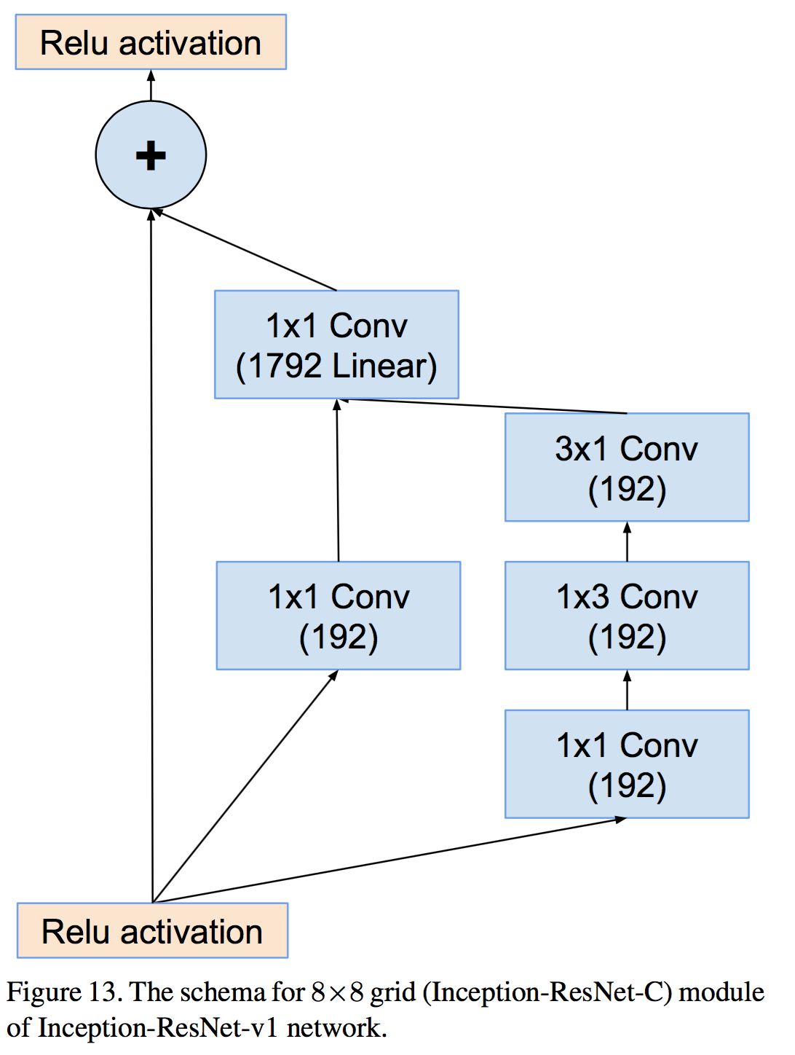
Inception-ResNet-v1

Slide 44
ResNet

Slide 45
Deep residual networks
152 layers network
1st place on ILSVRC 2015 classification task
1st place on ImageNet detection
1st place on ImageNet localization
1st place on COCO detection
1st place on COCO segmentation

Slide 46
Deeper Network?
Is deeper network always better?
What about vanishing/exploding gradients?
Better initialization methods / batch normalization / ReLU
Any other problems?
Overfitting?
Degradation problem: more depth but lower performance

Slide 47
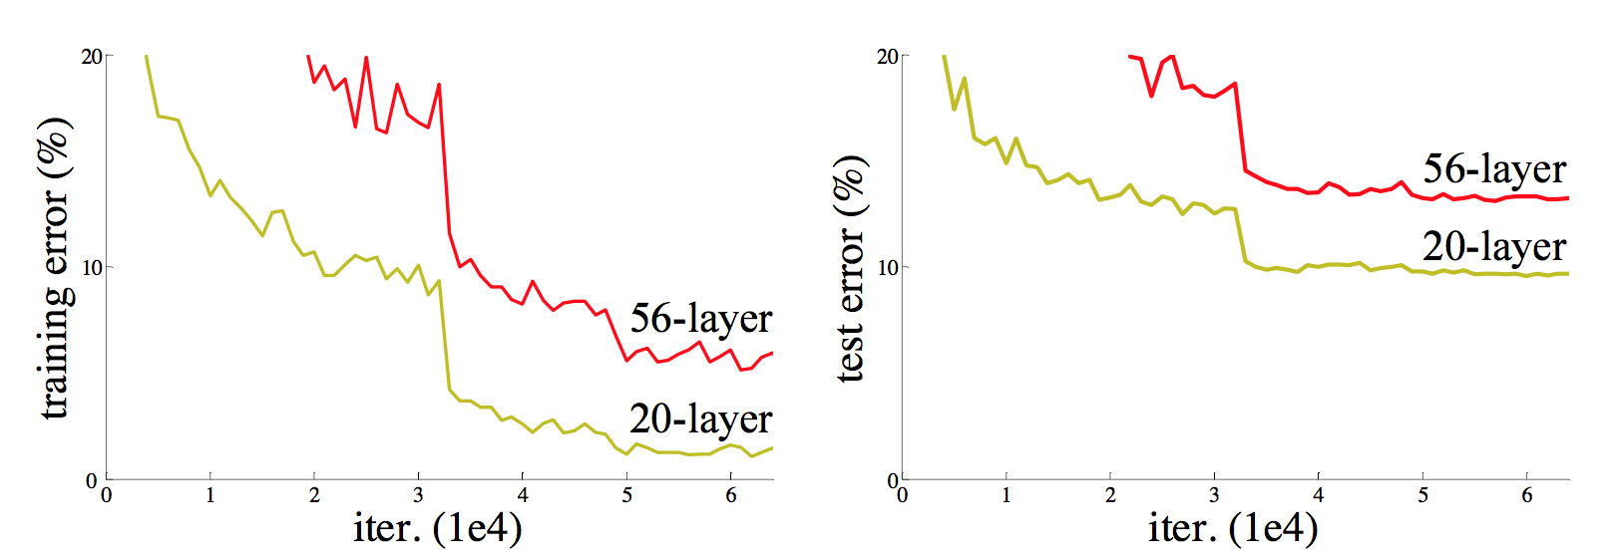
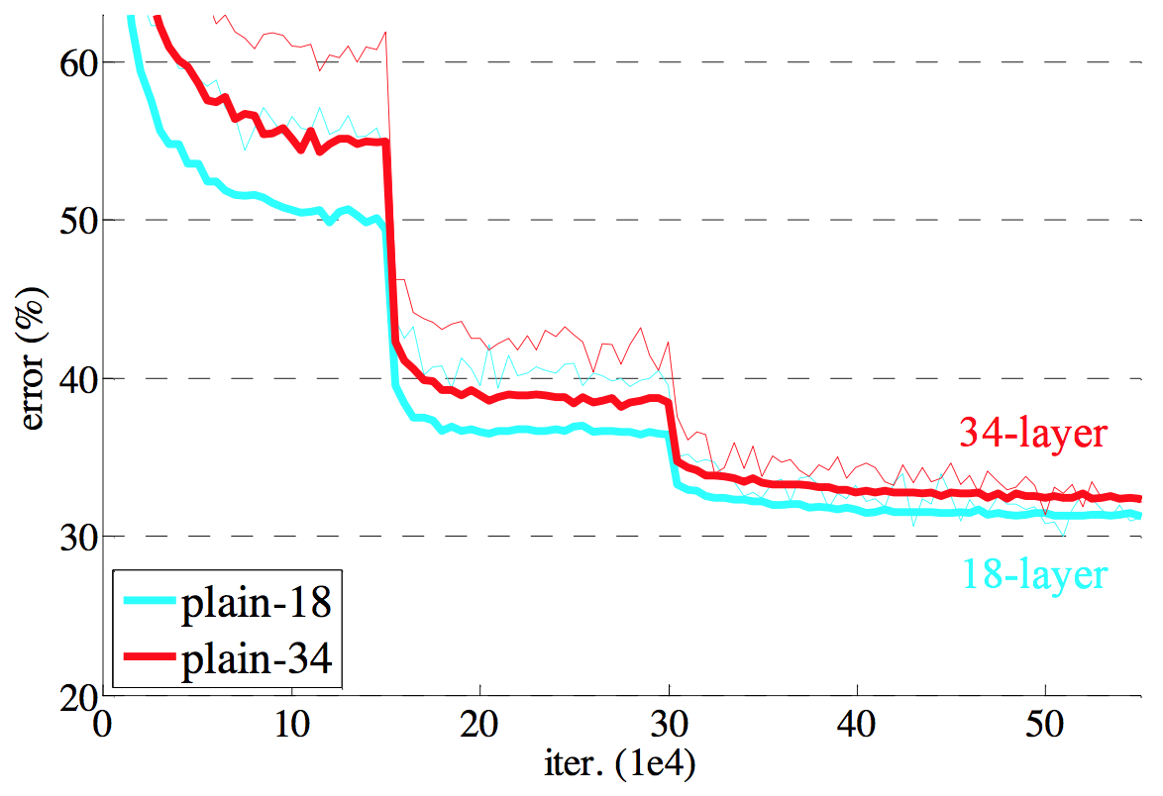
Degradation problem
CiFAR 100 Dataset
ImageNet

Slide 48
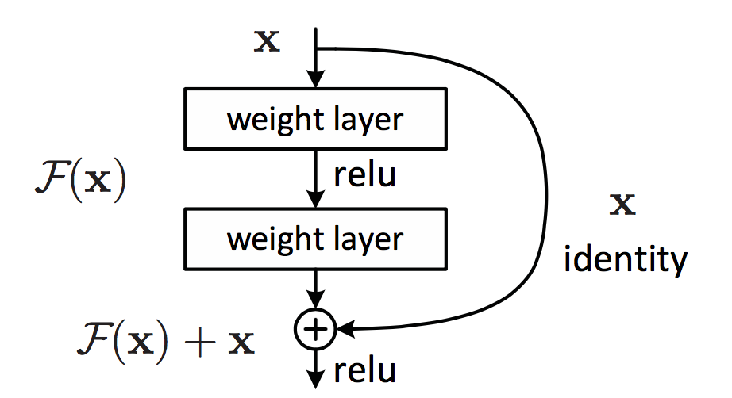
Residual learning building block

Slide 49
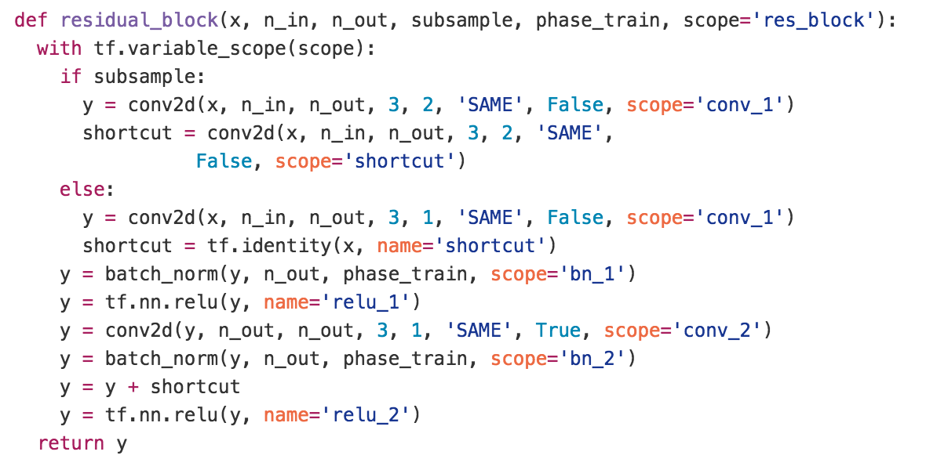
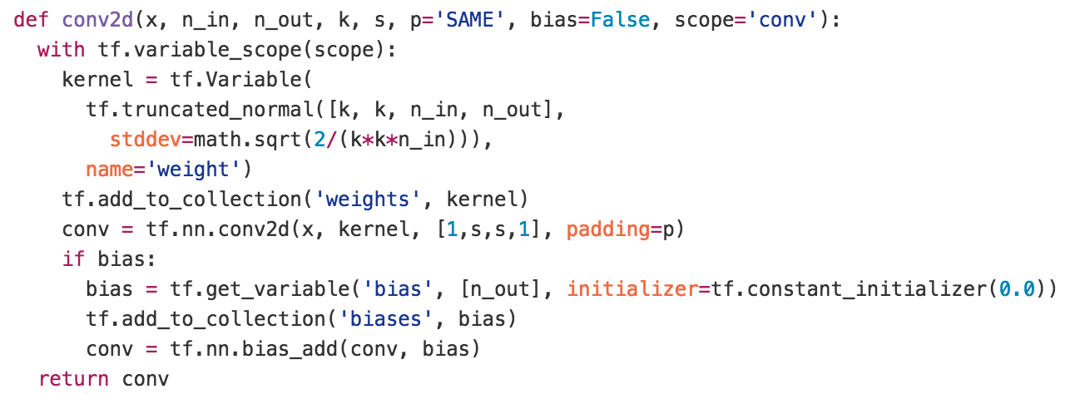
Residual learning building block
y
ReLU
+
y
conv2d
y
ReLU
y
conv2d
x

Slide 50
Why residual?
We hypothesize that it is easier to optimize the residual mapping than to optimize the original, unreferenced mapping.
Shortcut connections are used.

Slide 51
Why residual?
“The extremely deep residual nets are easy to optimize. “
“The deep residual nets can easily enjoy accuracy gains from greatly increased depth, producing results substantially better than previous networks. “

Slide 52
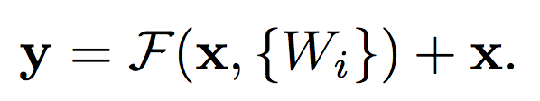
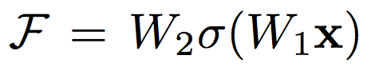
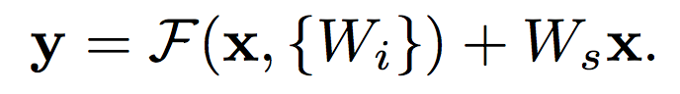
Residual mapping
Basic residual mapping (same dim.)
“But we will show by experiments that the identity mapping is sufficient for addressing the degradation problem and is economical, and thus W is only used when matching dimensions.”
Basic residual mapping (different dim.)

Slide 53

Deep residual network

Slide 54


Deeper bottle architecture
Dimension reduction
Convolution
Dimension increasement

Slide 55


Experimental results

Slide 56

Experimental results

